Slide 1




Finwise: Tailored Financial Solutions
Finwise is a comprehensive personal finance platform designed to empower individuals with advanced tools and insights to effectively manage their money. It offers a suite of features that cater to diverse financial needs, from in-depth analysis to personalized investment strategies.
by project project

Slide 2

Financial Analysis and Budget Planning
Finwise's advanced financial analysis tools empower users to gain deep insights into their spending patterns and income streams. Through interactive visualizations, users can create personalized budgets and monitor their financial health in real-time, ensuring responsible and informed money management.
Leveraging machine learning algorithms, Finwise's budget planning feature provides tailored recommendations to optimize expenses and maximize savings. Users can effortlessly track and categorize transactions, identify areas for improvement, and receive personalized guidance to achieve their financial goals.

Slide 3
Affordable Stock Prediction and Investment Strategies
Finwise's cutting-edge stock prediction algorithms analyze market trends, economic indicators, and historical data to provide users with affordable, data-driven investment recommendations. By leveraging advanced machine learning, the platform offers personalized strategies to help users build diversified portfolios and maximize returns.
Detailed stock analysis and forecasting
Personalized investment plans based on risk tolerance
Real-time portfolio monitoring and rebalancing
Educational resources on financial concepts and investment strategies

Slide 4
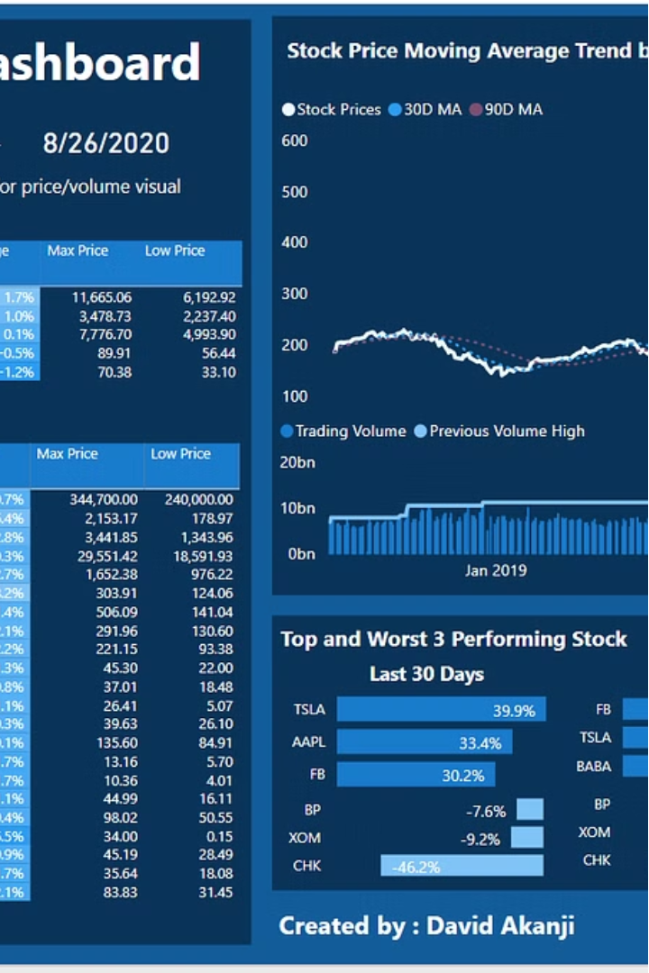
Market Analysis
Finwise's market analysis capabilities empower users to stay informed about the ever-evolving financial landscape. By aggregating and analyzing real-time data from various sources, the platform provides users with comprehensive insights into market trends, investment opportunities, and potential risks.
Through intuitive visualizations and customizable dashboards, Finwise users can monitor market indices, sector performance, and economic indicators to make informed decisions and adapt their investment strategies accordingly.

Slide 5
Expense Management and Optimization
Categorize Expenses
Identify Savings Opportunities
Finwise's intuitive expense tracking categorizes purchases into personalized groups, providing users with a clear overview of their spending habits.
The platform's AI-powered algorithms analyze user spending and recommend ways to optimize costs, highlighting areas for potential savings.
Personalized Budgeting
Automated Reminders
Finwise's smart budgeting tools create customized spending plans based on individual income and financial goals, empowering users to reach their targets.
Timely notifications about upcoming bills and subscription renewals help users stay on top of their finances and avoid late fees.

Slide 6



Financial Health Monitoring
Real-time Insights
Goal Tracking
Proactive Alerts
Finwise's comprehensive dashboard provides users with a real-time snapshot of their financial standing, empowering them to make data-driven decisions.
The platform's intelligent goal-setting and progress-monitoring tools help users stay on track with their financial objectives and celebrate milestones.
Finwise's smart alerts notify users of upcoming bills, budget deviations, and opportunities to optimize their finances, ensuring they never miss a beat.

Slide 7
Security and Privacy
Robust Security Protocols
Secure Authentication
Finwise employs industry-leading encryption and data protection measures to safeguard users' sensitive financial information, ensuring the utmost security for all transactions and account details.
The platform's multi-factor authentication system, including biometric options, provides an additional layer of protection to verify users' identities and prevent unauthorized access.
Privacy-Focused Design
Compliance and Regulation
Finwise is designed with a strong emphasis on user privacy, respecting personal data and giving individuals full control over how their information is used and shared.
The platform adheres to strict financial regulations and industry standards, ensuring that users' funds and data are managed in a compliant and ethical manner.

Slide 8
Key Features
Comprehensive Financial Analysis
Personalized Budgeting
Data-Driven Investments
Intuitive Market Insights
Smart budgeting features create customized spending plans aligned with your financial goals, helping you stay on track.
Affordable stock prediction and tailored investment strategies leverage machine learning to maximize your returns.
Real-time market analysis and customizable dashboards empower you to navigate the ever-changing financial landscape.
Finwise's advanced analytics tools provide in-depth insights into your spending patterns, income streams, and overall financial health.

Slide 9

Benefits
Finwise offers a range of powerful benefits to help you achieve your financial goals. From personalized budgeting tools to data-driven investment strategies, the platform empowers you to take control of your money and make informed decisions.
By leveraging advanced analytics and AI-powered insights, Finwise helps you streamline your finances, reduce expenses, and grow your wealth over time. With real-time monitoring and tailored guidance, you can confidently navigate the complex financial landscape and secure a brighter financial future.

Slide 10

Conclusion
Finwise is the all-in-one financial solution that empowers you to take control of your finances. By seamlessly integrating cutting-edge technology and personalized insights, the platform helps you achieve your financial goals and secure a brighter future.

